Slide 1
TM
2018 Release (ISR49) (Capture Constraint Manager)

Slide 2
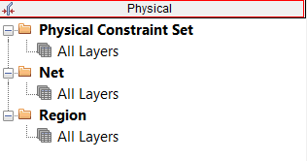
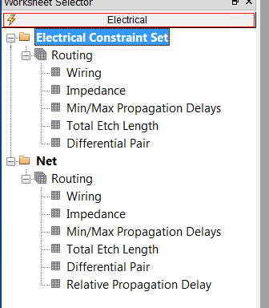
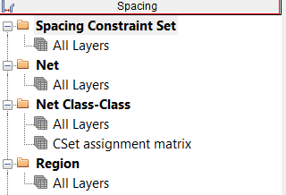
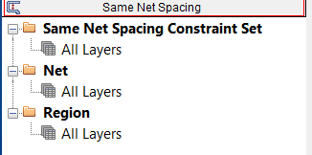
Capture Constraint Manager
Why Constraint Manger in Capture?
Capture users have been asking for constraint support for a long time
Familiar spreadsheet based structure
Customers are doing designs with DDR and other advanced interfaces
Require advanced constraints
Excellent Maintenance Upgrade opportunity for CCPs
Electrical, Physical, Mechanical, and Manufacturing Rules
Wiring, Impedance, Propagation, Differential Pairs
Line, Pin, Pin Pairs, Via, Shape, Hole Spacing
Line, Neck Width, Differential Spacing

Slide 3
Capture Constraint Manager – F2B Constraints
What is it?
Constraint driven flow enabled through ONE Constraint Manager whether the user is working with schematics, SI or layout; no translation of CONSTRAINTS
What it does?
Allows a designer to easily capture constraints in the schematic that can be used for floor planning, placement, and interactive routing
Benefits
Constraint Driven PCB layout ensures design accuracy shortening time to manufacturing while optimizing end product cost

Slide 4
Rules, Rules, and More Rules
Design Complexities are Growing and Form Factor is shrinking
Number of constraints on a PCB is growing rapidly
Pressure is to reduce cost and design time
Not managing constraints from front to back can cause:
Unnecessary physical prototype iterations can be avoided
Non-optimal product performance
Expensive end product per unit cost
Need simple, easy to use, well integrated and proven solution
Predictable
Design Cycle time
% of nets constrained →

Slide 5
How the Capture Engineer Communicates Design Intent
How do these rules get communicated?
Verbally, docs, spreadsheets, email, post-its
How do rules get checked?
Manual design reviews
Prototyping
Final verification / simulation
Problems
Missed or misunderstood requirements
Designs not fully verified (respins)
Problems not found until late in design
Notes
Word Documents
Spreadsheets
Today, the rules are communicated in an ad-hoc way and can be mis-understood
Meetings
Emails
Calls
Schematics
Sticky Notes

Slide 6
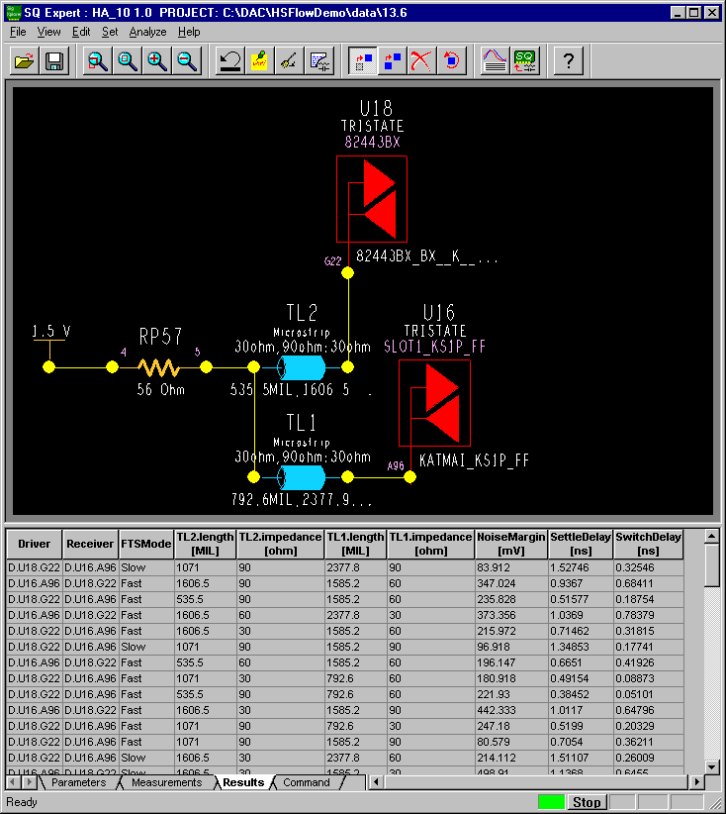
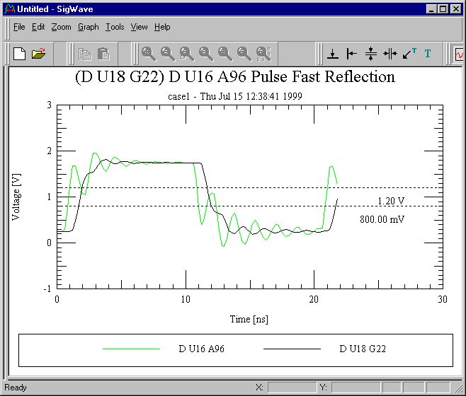
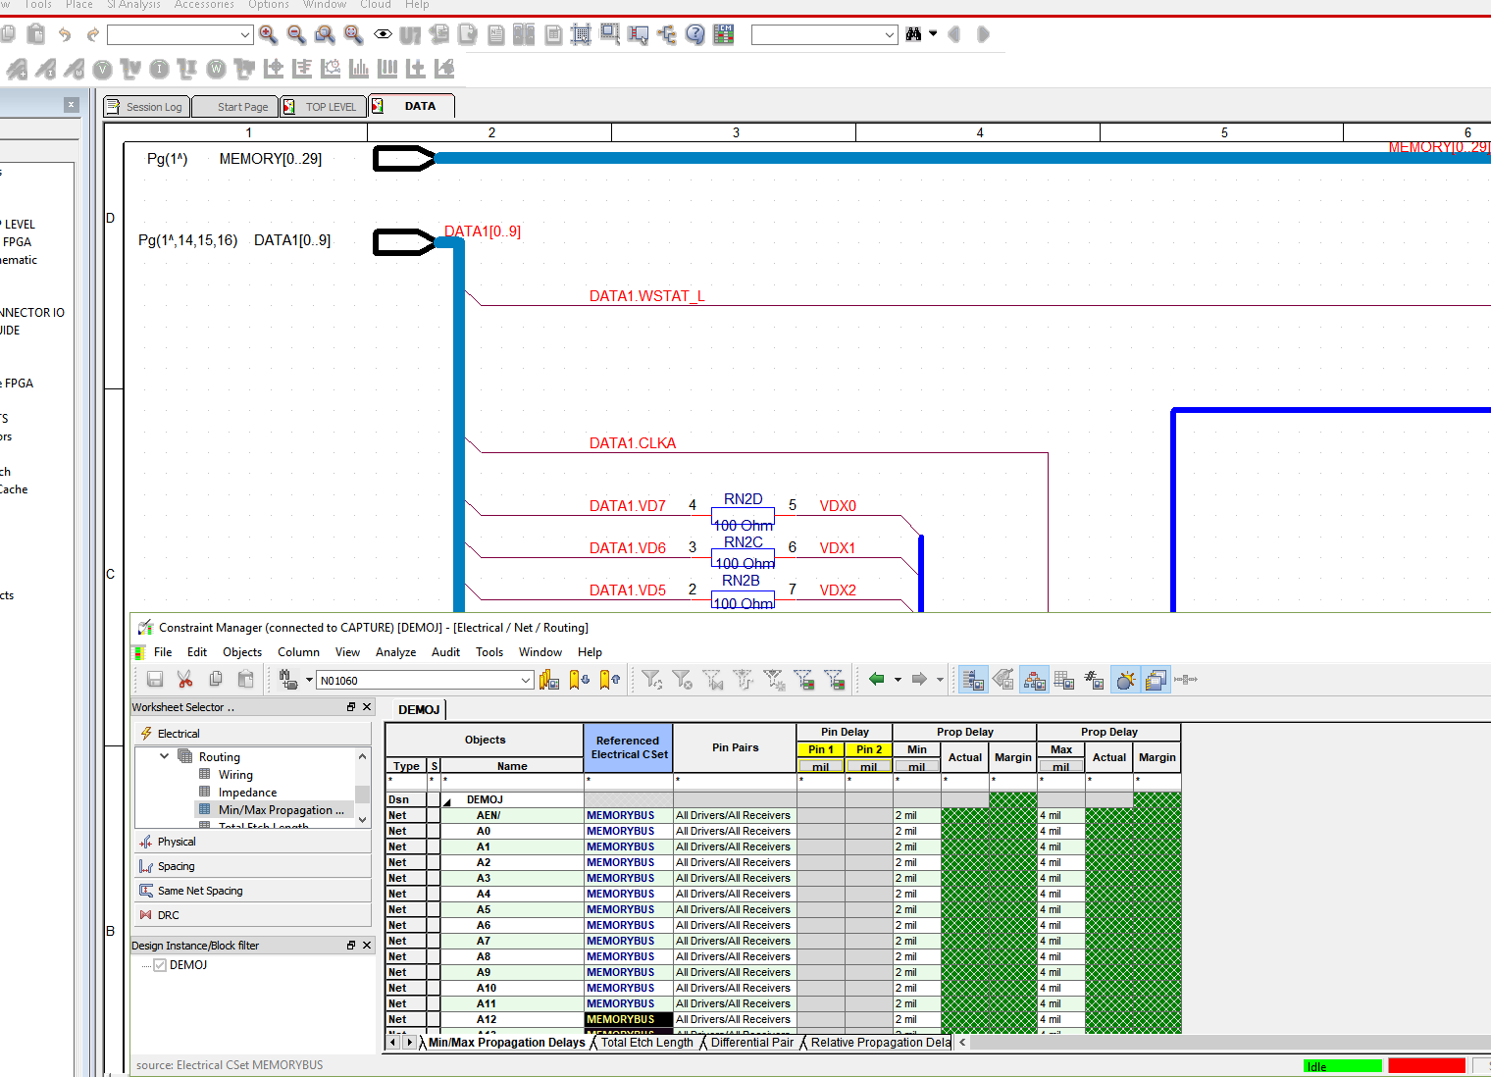
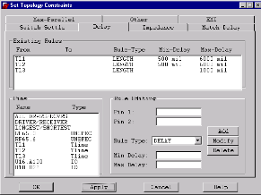
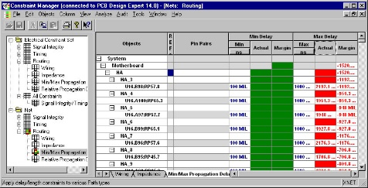
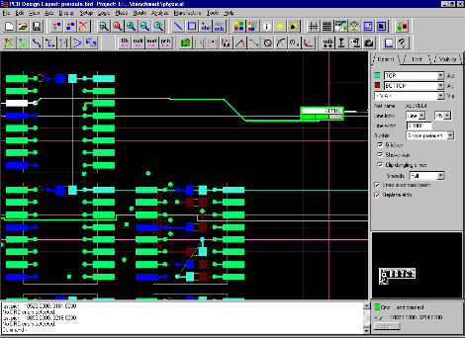
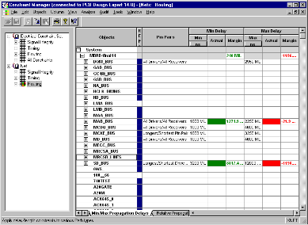
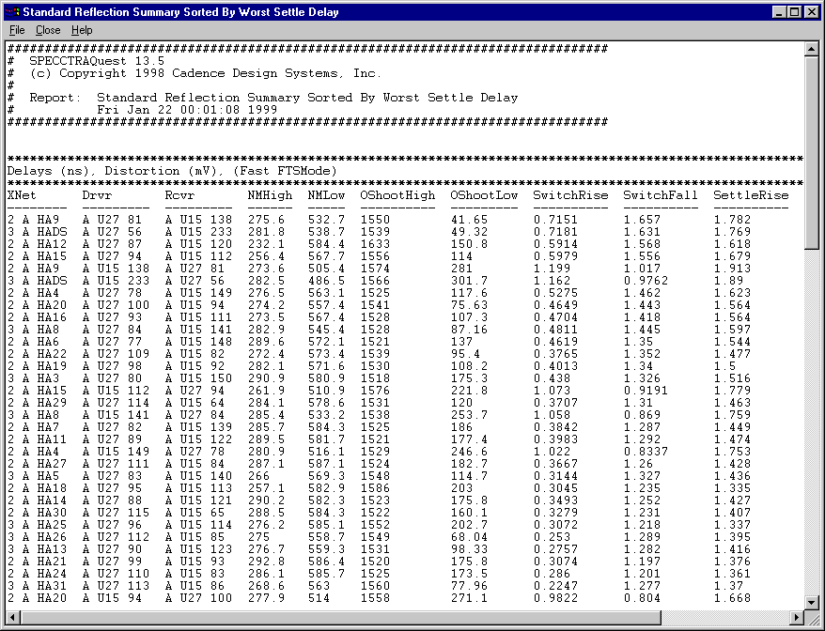
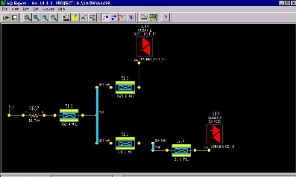
Constraint-Driven PCB Design Flow – Real Time Design
Exploration: Derive Design Rules & Topologies
Constraint Driven Floorplanning and placement
Implementation: Design Creation with multi-style Editor
Post Route Verification
Constraint Driven Routing

Slide 7
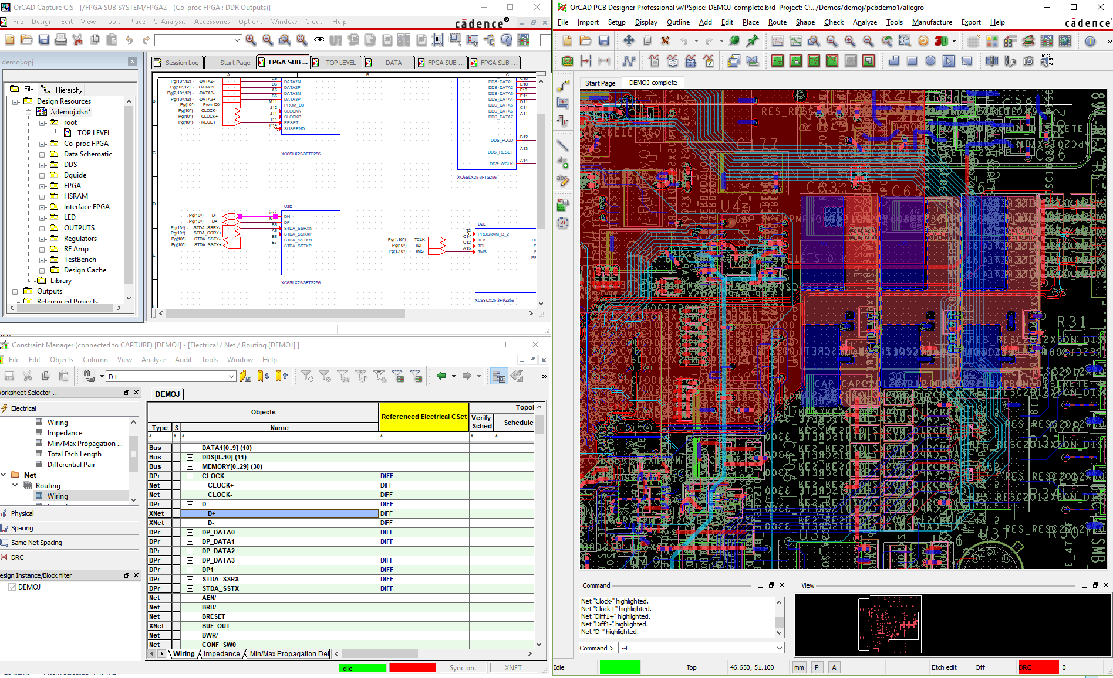
Completely Integrated Solution
Constraint driven flow enabled through ONE Constraint Manager
One GUI, one way to interact with CM whether the user is working with schematics or with layout; no translation of CONSTRAINTS
Familiar spreadsheet based structure
Constraints part of design intent, travel with netlist to layout
Constraint Driven Floor planning, placement and interactive routing
Cross probe directly with design canvas

Slide 8
Real-Time Feedback
Fix errors as they happen
Errors immediately displayed on screen
Real-time heads up display for length tuning
Don’t compound problems
Prevent design decisions being made on incorrect assumptions
Rule violation flagged
Add tuning
Until
constraint is met
Clean route – no DRCs

Slide 9
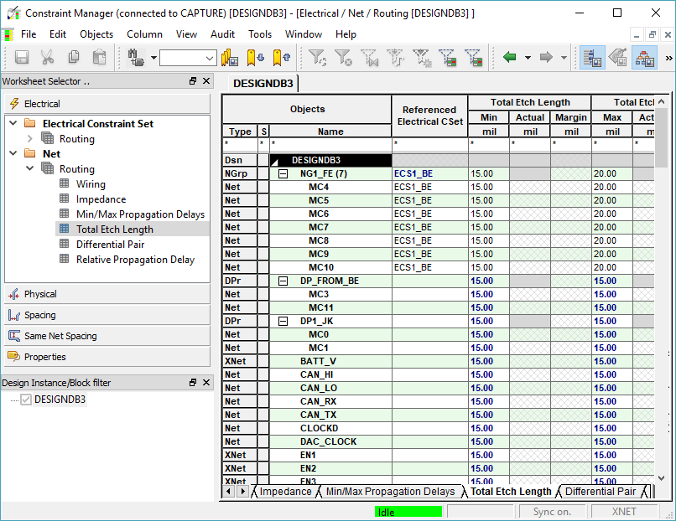
What is constraint manager (CM) ?
Spread sheet based utility for constraint definition
Clean layout for each constraints type
Define and categorize connectivity objects based on functionality
Differential pair
Pin pairs
Net class
Cross-probe in real time

Slide 10
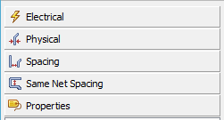
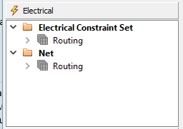
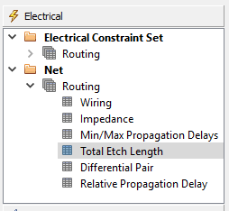
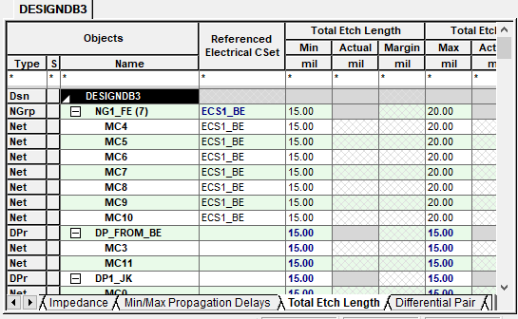
OrCAD Constraint Manager-Overview
Each Constraint type arranged as content pane
Each content pane has spreadsheet denoting functional type and associated constraints

Slide 11
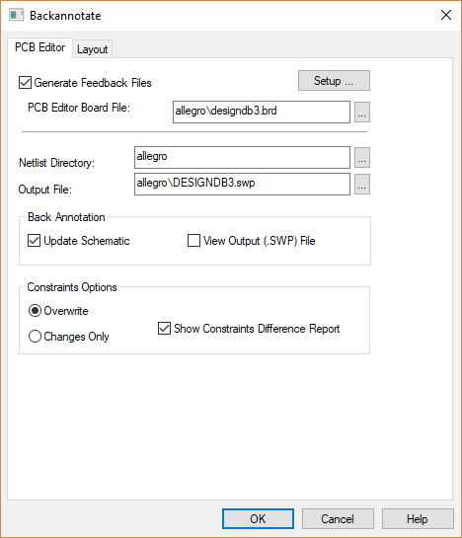
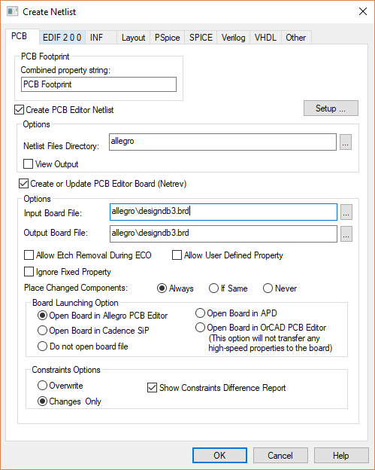
OrCAD Constraint Manager Flow
Easy to use spreadsheet based constraint assignment
Arrangement of constraint based on domain
Quickly browse across spreadsheet.
Seamless transfer of constraints with existing front-to-back and back-to-front flow
Constraint information saved in .dsn (data source name)
No need of additional files to share design and constraints. use single file format
Work on multiple designs in single session

Slide 12
Capture - Constraint Manager License Tiering
Functionality of Capture CM aligned with CM functionality in corresponding tier of PCB Editor
Capture standalone licenses will support PCB Designer Standard CM functionality
Product | CM Functionality
Capture Allegro Design Entry Capture | OrCAD PCB Editor Standard
OrCAD PCB Designer Standard | OrCAD PCB Editor Standard
Capture CIS Allegro Design Authoring - Capture CIS OrCAD PCB Designer Professional | OrCAD PCB Editor Professional

Slide 13
Supported Constraint Sets Aligned with Appropriate Tier of PCB Editor
Constraints | PCB Designer Standard | PCB Designer Professional
Electrical Constraint Set
Physical Constraint Set
Spacing Constraint Set
Same Net Spacing
Constraints
Differential pair
Xnet Visibility
Xnet Creation/Deletion
Relative propagation delays
Wiring
Impedances
Min/Max Propagation delays
Total Etch length

Slide 14
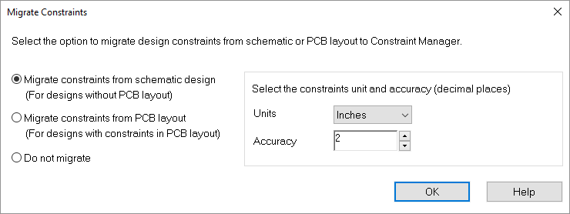
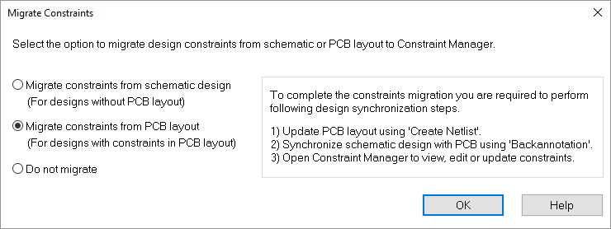
Using Capture Constraint Manager
CM based PCB design flow is optional
Existing flow continues to be supported as is
Enable CM on design based on need
One time activity- can be done at any phase of PCB flow
On new Schematic
Existing Schematic (with or without constraints)
Existing Schematic with physical Layout
Existing constraints will be migrated to CM

Slide 15
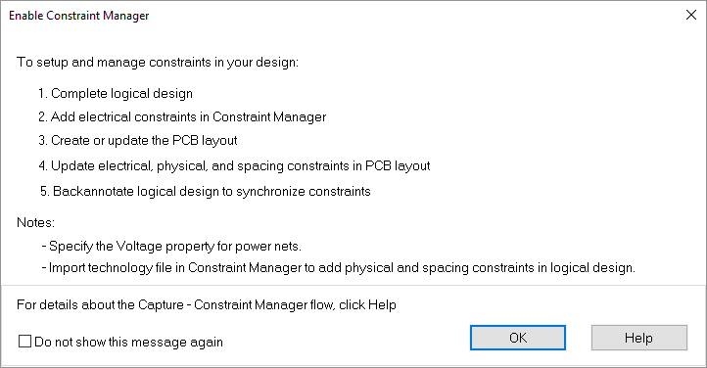
Enabling Constraint Manager
How to enable CM on your designs
Back up your complete design data
Make sure your schematic and PCB are in-synch
Click on CM icon in Capture
Follow the recommended flow in the dialog after CM enabling

Slide 16
Enabling Constraint Manager
New Schematic
Complete schematic entry
Click CM icon
Select migrate constraint from schematic
Assign voltage value for Power nets
CM UI opens
Click CM icon
In migration dialog select migrate constraints from schematic and click OK
CM launches (CM enabled)

Slide 17
Enabling Constraint Manager
Existing Schematic with or without constraints
Click CM icon
Select migrate constraint from schematic
Assign voltage value for Power nets
CM UI opens –indicating CM enablement
Review session log for migrated constraints and constraints properties (if any)
Use CM to edit/update constraints
Click CM icon
In migration dialog select migrate constraints from schematic and click OK
CM launches (CM enabled)

Slide 18
Enabling Constraint Manager
Existing Schematic with constraints in PCB layout
Click CM icon
Select migrate constraint from PCB layout
Assign voltage value for Power nets
Update PCB layout using ‘Create Netlist’
Synchronize schematic design to PCB using ‘Back annotation’
Use CM in Capture to review existing constraints and add/update constraints
Click CM icon
In migration dialog select “Migrate constraints from PCB layout“ and click OK
Click CM icon to open CM (CM enabled)
Run Front-to-Back
Run Back-to-Front

Slide 19
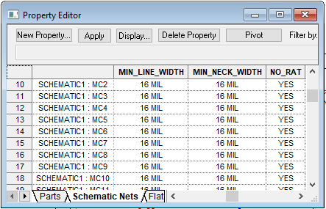
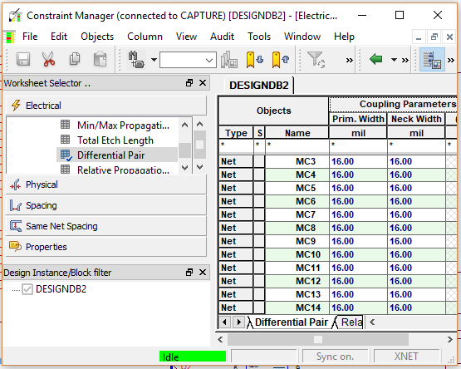
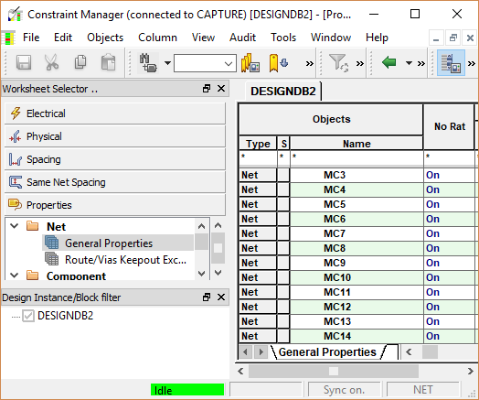
What will change in your schematic design
Property Editor
All constraints and constraints related properties will be managed from CM UI only applies to
Nets
Components
Pins

Slide 20
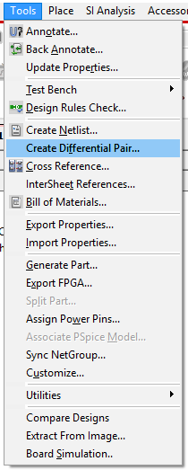
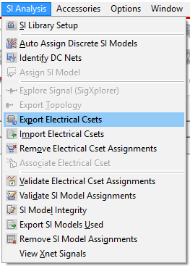
What will change in your schematic design
Manage all constraints and related operation from single interface
Following operations moved from Capture to CM
ECSet menu items
View Xnet Signals
Create “Differential pair”
These continue to be supported in Capture for legacy design mode (CM not enabled)

Slide 21
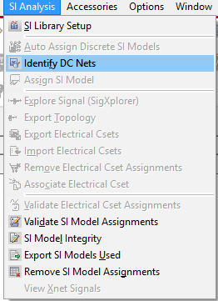
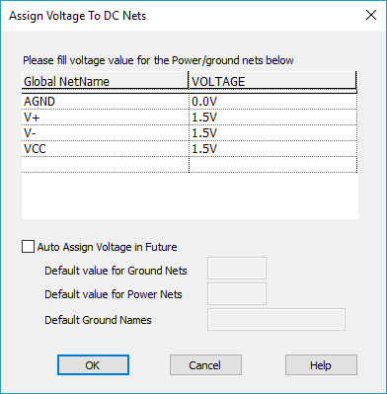
What will change in your schematic design
Must assign voltage on power nets
Essential for constraint transfer in Capture CM PCB flow
Use “Assign Voltage to DC nets” dialog
Capture will auto assign value based on net names

Slide 22
Capture Constraint manger - Supported objects
Along with constraints Capture CM supports creation and management of following constraint objects
All Xnets
Diffrential pairs
ECSet
Match Group
Pin Pair
Net-Class
Constraint Set
Ecset (Electrical)
Pcset (Physical)
Scset (Spacing)

Slide 23
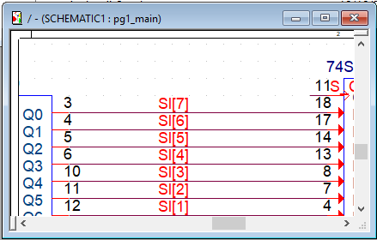
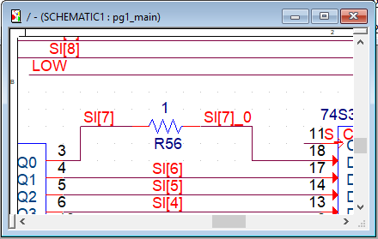
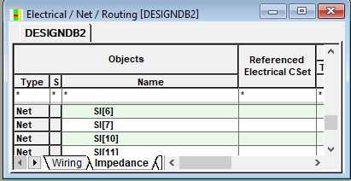
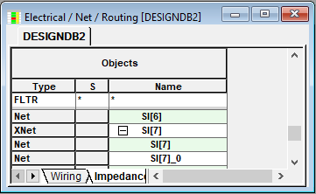
Capture Constraint Manager - Xnets
Auto Xnet Creation
Auto creation of XNet on Discrete parts
For Non discrete parts Xnets can be created by XNET_PINS property.

Slide 24
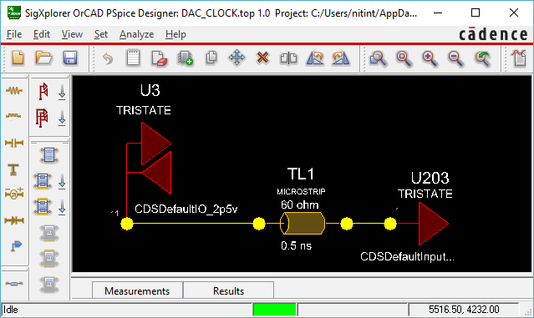
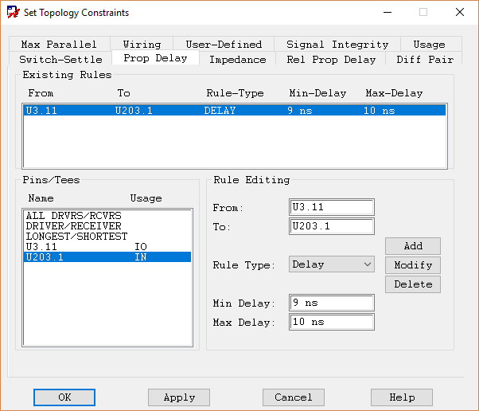
Capture Constraint Manager – Signal Integrity
SigXp topology explorer
View/explore topology
Assign constraints
Constraint assignment in SigXp requires SI based license

Slide 25
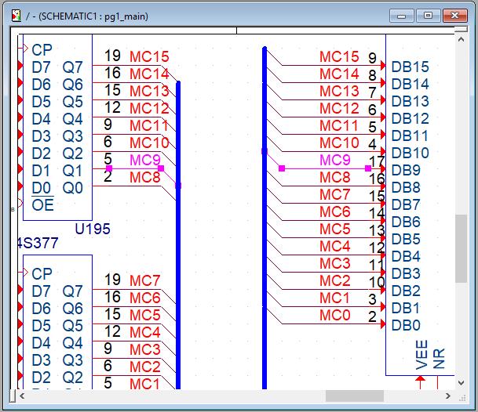
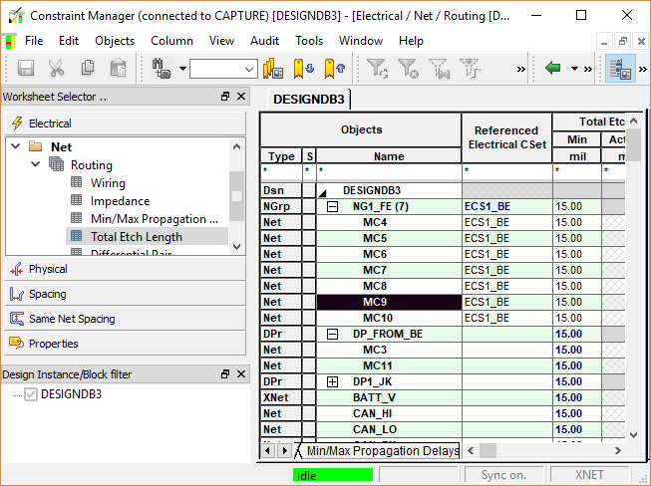
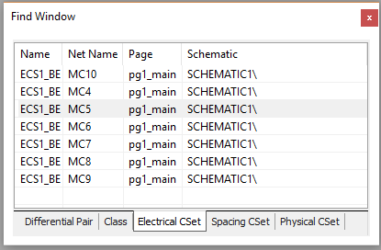
Capture Constraint Manager – Finding constraints
Find utility enhancement
Find Constraints on schematic
Cross-probe from schematic to CM UI

Slide 26
Capture Constraint Manager - Tips
Constraints are saved at the time of design save
Undo and Redo on schematic and CM UI are limited in their own environment
Undo Redo changes from schematic to CM UI have limited capability
Stack-up details are needed to manage physical and spacing constraints in Capture CM
Import tech file in Capture-CM
Run back-annotation from PCB – this automatically brings stack up details in Capture CM
Always manage constraint at one place - Schematic or PCB Layout
Avoid constraints modification simultaneous at both ends

